Slide 1
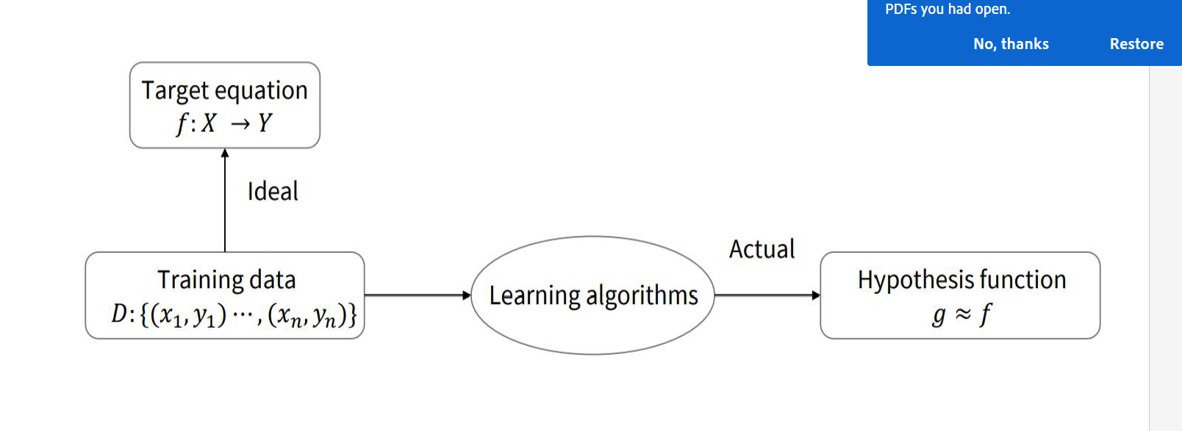

Slide 2
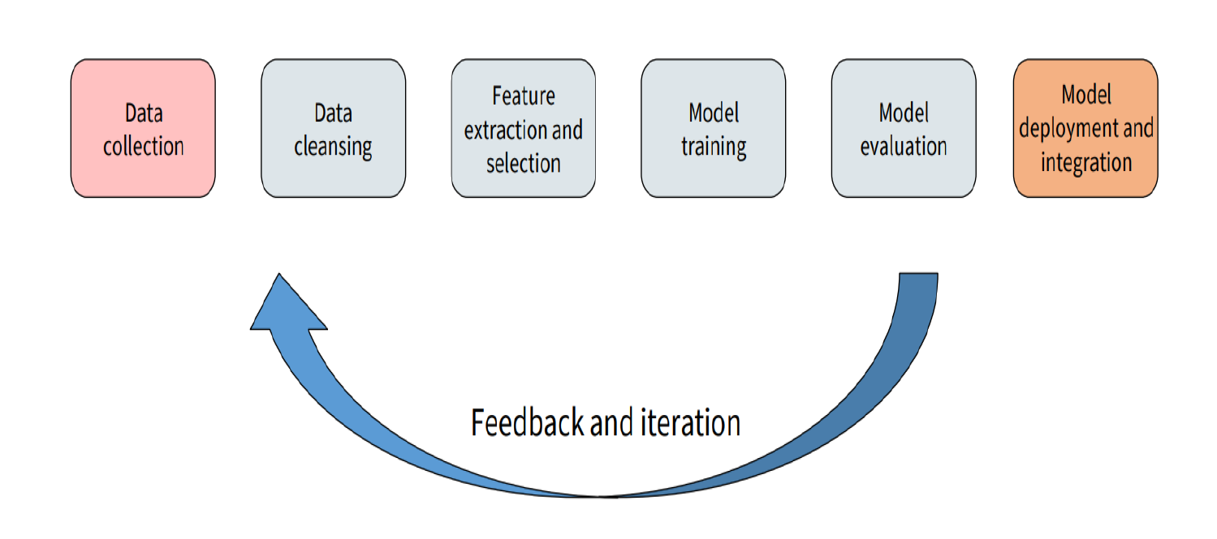

Slide 3
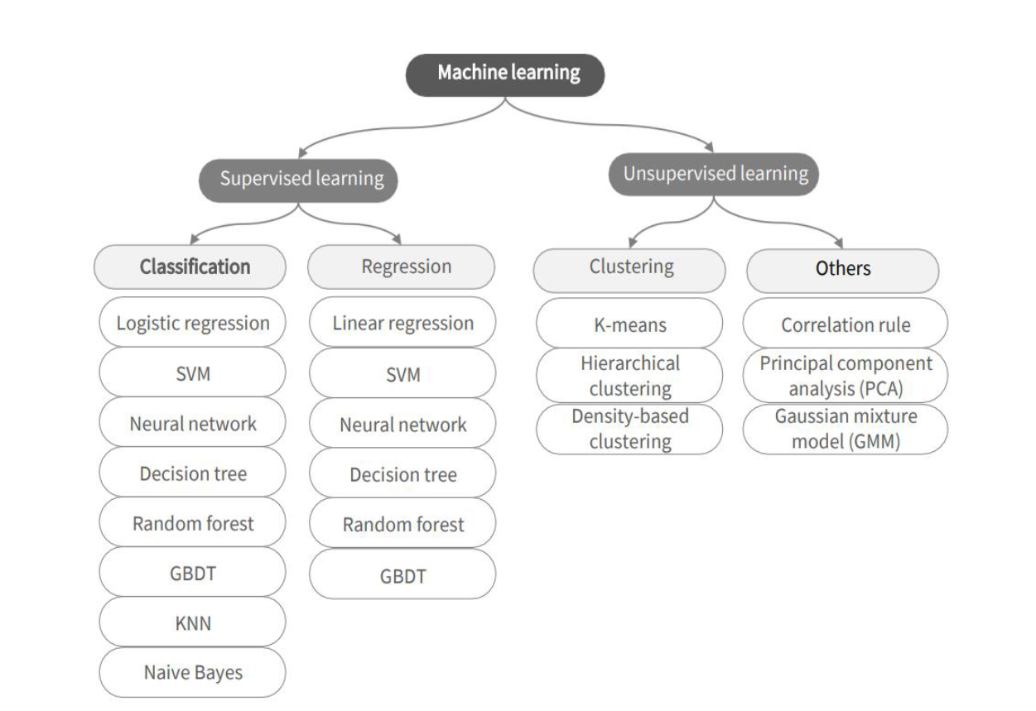

Slide 4

ML vs. Deep Learning
Deep learning (DL) is a machine learning subfield that uses multiple layers for learning data representations
DL is exceptionally effective at learning patterns
Time consuming/feature dimensions

Slide 5
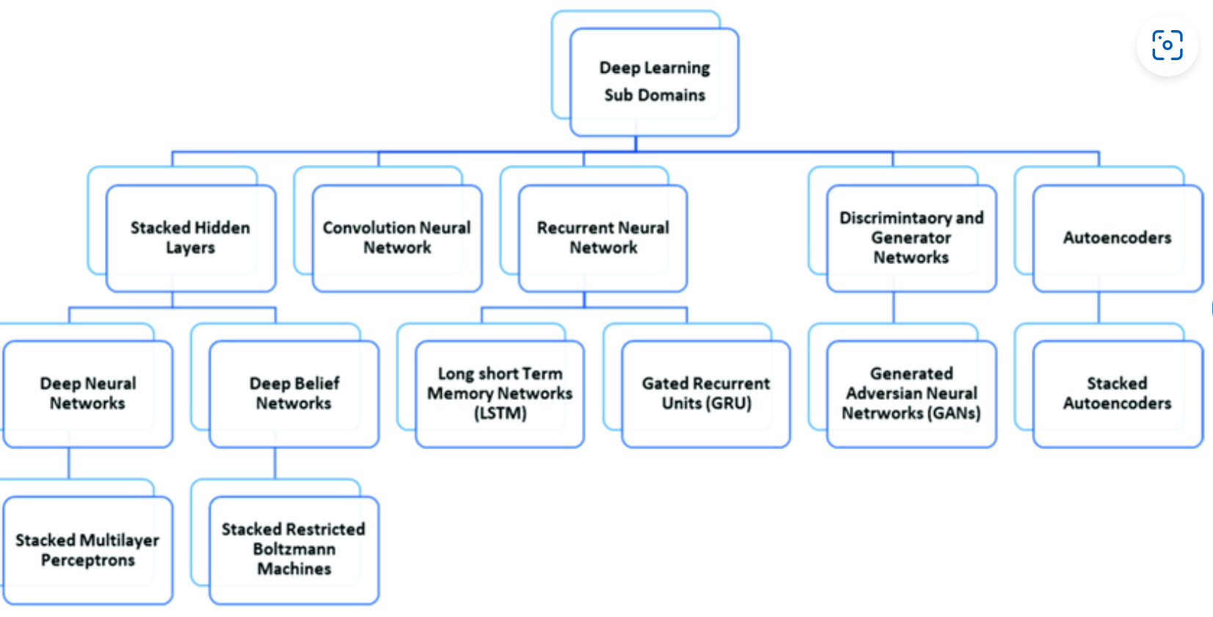

Slide 6
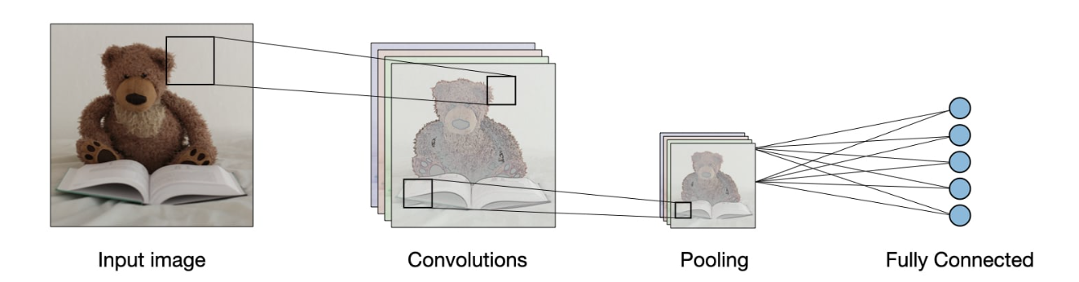

Slide 7
First, let’s discuss briefly Image filtering

Slide 8
Image filtering
Image filtering: compute function of local neighborhood at each position
Really important!
Enhance images
Denoise, resize, increase contrast, etc.
Extract information from images
Texture, edges, distinctive points, etc.
Detect patterns
Template matching
Deep Convolutional Networks

Slide 9

Example: box filter
1
1
1
1
1
1
1
1
1
Slide credit: David Lowe (UBC)

Slide 10
Image filtering
1
1
1
1
1
1
1
1
1
0 | 0 | 0 | 0 | 0 | 0 | 0 | 0 | 0 | 0
0 | 0 | 0 | 0 | 0 | 0 | 0 | 0 | 0 | 0
0 | 0 | 0 | 90 | 90 | 90 | 90 | 90 | 0 | 0
0 | 0 | 0 | 90 | 90 | 90 | 90 | 90 | 0 | 0
0 | 0 | 0 | 90 | 90 | 90 | 90 | 90 | 0 | 0
0 | 0 | 0 | 90 | 0 | 90 | 90 | 90 | 0 | 0
0 | 0 | 0 | 90 | 90 | 90 | 90 | 90 | 0 | 0
0 | 0 | 0 | 0 | 0 | 0 | 0 | 0 | 0 | 0
0 | 0 | 90 | 0 | 0 | 0 | 0 | 0 | 0 | 0
0 | 0 | 0 | 0 | 0 | 0 | 0 | 0 | 0 | 0
 | 0
0 | 0 | 0 | 0 | 0 | 0 | 0 | 0 | 0 | 0
0 | 0 | 0 | 0 | 0 | 0 | 0 | 0 | 0 | 0
0 | 0 | 0 | 90 | 90 | 90 | 90 | 90 | 0 | 0
0 | 0 | 0 | 90 | 90 | 90 | 90 | 90 | 0 | 0
0 | 0 | 0 | 90 | 90 | 90 | 90 | 90 | 0 | 0
0 | 0 | 0 | 90 | 0 | 90 | 90 | 90 | 0 | 0
0 | 0 | 0 | 90 | 90 | 90 | 90 | 90 | 0 | 0
0 | 0 | 0 | 0 | 0 | 0 | 0 | 0 | 0 | 0
0 | 0 | 90 | 0 | 0 | 0 | 0 | 0 | 0 | 0
0 | 0 | 0 | 0 | 0 | 0 | 0 | 0 | 0 | 0
Credit: S. Seitz
Notes:
ones, divide by 9

Slide 11
Image filtering
1
1
1
1
1
1
1
1
1
0 | 0 | 0 | 0 | 0 | 0 | 0 | 0 | 0 | 0
0 | 0 | 0 | 0 | 0 | 0 | 0 | 0 | 0 | 0
0 | 0 | 0 | 90 | 90 | 90 | 90 | 90 | 0 | 0
0 | 0 | 0 | 90 | 90 | 90 | 90 | 90 | 0 | 0
0 | 0 | 0 | 90 | 90 | 90 | 90 | 90 | 0 | 0
0 | 0 | 0 | 90 | 0 | 90 | 90 | 90 | 0 | 0
0 | 0 | 0 | 90 | 90 | 90 | 90 | 90 | 0 | 0
0 | 0 | 0 | 0 | 0 | 0 | 0 | 0 | 0 | 0
0 | 0 | 90 | 0 | 0 | 0 | 0 | 0 | 0 | 0
0 | 0 | 0 | 0 | 0 | 0 | 0 | 0 | 0 | 0
 | 0 | 10
0 | 0 | 0 | 0 | 0 | 0 | 0 | 0 | 0 | 0
0 | 0 | 0 | 0 | 0 | 0 | 0 | 0 | 0 | 0
0 | 0 | 0 | 90 | 90 | 90 | 90 | 90 | 0 | 0
0 | 0 | 0 | 90 | 90 | 90 | 90 | 90 | 0 | 0
0 | 0 | 0 | 90 | 90 | 90 | 90 | 90 | 0 | 0
0 | 0 | 0 | 90 | 0 | 90 | 90 | 90 | 0 | 0
0 | 0 | 0 | 90 | 90 | 90 | 90 | 90 | 0 | 0
0 | 0 | 0 | 0 | 0 | 0 | 0 | 0 | 0 | 0
0 | 0 | 90 | 0 | 0 | 0 | 0 | 0 | 0 | 0
0 | 0 | 0 | 0 | 0 | 0 | 0 | 0 | 0 | 0
Credit: S. Seitz
Notes:
ones, divide by 9

Slide 12
Image filtering
1
1
1
1
1
1
1
1
1
0 | 0 | 0 | 0 | 0 | 0 | 0 | 0 | 0 | 0
0 | 0 | 0 | 0 | 0 | 0 | 0 | 0 | 0 | 0
0 | 0 | 0 | 90 | 90 | 90 | 90 | 90 | 0 | 0
0 | 0 | 0 | 90 | 90 | 90 | 90 | 90 | 0 | 0
0 | 0 | 0 | 90 | 90 | 90 | 90 | 90 | 0 | 0
0 | 0 | 0 | 90 | 0 | 90 | 90 | 90 | 0 | 0
0 | 0 | 0 | 90 | 90 | 90 | 90 | 90 | 0 | 0
0 | 0 | 0 | 0 | 0 | 0 | 0 | 0 | 0 | 0
0 | 0 | 90 | 0 | 0 | 0 | 0 | 0 | 0 | 0
0 | 0 | 0 | 0 | 0 | 0 | 0 | 0 | 0 | 0
 | 0 | 10 | 20
0 | 0 | 0 | 0 | 0 | 0 | 0 | 0 | 0 | 0
0 | 0 | 0 | 0 | 0 | 0 | 0 | 0 | 0 | 0
0 | 0 | 0 | 90 | 90 | 90 | 90 | 90 | 0 | 0
0 | 0 | 0 | 90 | 90 | 90 | 90 | 90 | 0 | 0
0 | 0 | 0 | 90 | 90 | 90 | 90 | 90 | 0 | 0
0 | 0 | 0 | 90 | 0 | 90 | 90 | 90 | 0 | 0
0 | 0 | 0 | 90 | 90 | 90 | 90 | 90 | 0 | 0
0 | 0 | 0 | 0 | 0 | 0 | 0 | 0 | 0 | 0
0 | 0 | 90 | 0 | 0 | 0 | 0 | 0 | 0 | 0
0 | 0 | 0 | 0 | 0 | 0 | 0 | 0 | 0 | 0
Credit: S. Seitz
Notes:
ones, divide by 9

Slide 13
Image filtering
1
1
1
1
1
1
1
1
1
0 | 0 | 0 | 0 | 0 | 0 | 0 | 0 | 0 | 0
0 | 0 | 0 | 0 | 0 | 0 | 0 | 0 | 0 | 0
0 | 0 | 0 | 90 | 90 | 90 | 90 | 90 | 0 | 0
0 | 0 | 0 | 90 | 90 | 90 | 90 | 90 | 0 | 0
0 | 0 | 0 | 90 | 90 | 90 | 90 | 90 | 0 | 0
0 | 0 | 0 | 90 | 0 | 90 | 90 | 90 | 0 | 0
0 | 0 | 0 | 90 | 90 | 90 | 90 | 90 | 0 | 0
0 | 0 | 0 | 0 | 0 | 0 | 0 | 0 | 0 | 0
0 | 0 | 90 | 0 | 0 | 0 | 0 | 0 | 0 | 0
0 | 0 | 0 | 0 | 0 | 0 | 0 | 0 | 0 | 0
 | 0 | 10 | 20 | 30
0 | 0 | 0 | 0 | 0 | 0 | 0 | 0 | 0 | 0
0 | 0 | 0 | 0 | 0 | 0 | 0 | 0 | 0 | 0
0 | 0 | 0 | 90 | 90 | 90 | 90 | 90 | 0 | 0
0 | 0 | 0 | 90 | 90 | 90 | 90 | 90 | 0 | 0
0 | 0 | 0 | 90 | 90 | 90 | 90 | 90 | 0 | 0
0 | 0 | 0 | 90 | 0 | 90 | 90 | 90 | 0 | 0
0 | 0 | 0 | 90 | 90 | 90 | 90 | 90 | 0 | 0
0 | 0 | 0 | 0 | 0 | 0 | 0 | 0 | 0 | 0
0 | 0 | 90 | 0 | 0 | 0 | 0 | 0 | 0 | 0
0 | 0 | 0 | 0 | 0 | 0 | 0 | 0 | 0 | 0
Credit: S. Seitz
Notes:
ones, divide by 9

Slide 14
Image filtering
1
1
1
1
1
1
1
1
1
0 | 0 | 0 | 0 | 0 | 0 | 0 | 0 | 0 | 0
0 | 0 | 0 | 0 | 0 | 0 | 0 | 0 | 0 | 0
0 | 0 | 0 | 90 | 90 | 90 | 90 | 90 | 0 | 0
0 | 0 | 0 | 90 | 90 | 90 | 90 | 90 | 0 | 0
0 | 0 | 0 | 90 | 90 | 90 | 90 | 90 | 0 | 0
0 | 0 | 0 | 90 | 0 | 90 | 90 | 90 | 0 | 0
0 | 0 | 0 | 90 | 90 | 90 | 90 | 90 | 0 | 0
0 | 0 | 0 | 0 | 0 | 0 | 0 | 0 | 0 | 0
0 | 0 | 90 | 0 | 0 | 0 | 0 | 0 | 0 | 0
0 | 0 | 0 | 0 | 0 | 0 | 0 | 0 | 0 | 0
 | 0 | 10 | 20 | 30 | 30
Credit: S. Seitz
Notes:
ones, divide by 9

Slide 15
Image filtering
1
1
1
1
1
1
1
1
1
0 | 0 | 0 | 0 | 0 | 0 | 0 | 0 | 0 | 0
0 | 0 | 0 | 0 | 0 | 0 | 0 | 0 | 0 | 0
0 | 0 | 0 | 90 | 90 | 90 | 90 | 90 | 0 | 0
0 | 0 | 0 | 90 | 90 | 90 | 90 | 90 | 0 | 0
0 | 0 | 0 | 90 | 90 | 90 | 90 | 90 | 0 | 0
0 | 0 | 0 | 90 | 0 | 90 | 90 | 90 | 0 | 0
0 | 0 | 0 | 90 | 90 | 90 | 90 | 90 | 0 | 0
0 | 0 | 0 | 0 | 0 | 0 | 0 | 0 | 0 | 0
0 | 0 | 90 | 0 | 0 | 0 | 0 | 0 | 0 | 0
0 | 0 | 0 | 0 | 0 | 0 | 0 | 0 | 0 | 0
 | 0 | 10 | 20 | 30 | 30
?
Credit: S. Seitz
Notes:
ones, divide by 9

Slide 16
Image filtering
1
1
1
1
1
1
1
1
1
0 | 0 | 0 | 0 | 0 | 0 | 0 | 0 | 0 | 0
0 | 0 | 0 | 0 | 0 | 0 | 0 | 0 | 0 | 0
0 | 0 | 0 | 90 | 90 | 90 | 90 | 90 | 0 | 0
0 | 0 | 0 | 90 | 90 | 90 | 90 | 90 | 0 | 0
0 | 0 | 0 | 90 | 90 | 90 | 90 | 90 | 0 | 0
0 | 0 | 0 | 90 | 0 | 90 | 90 | 90 | 0 | 0
0 | 0 | 0 | 90 | 90 | 90 | 90 | 90 | 0 | 0
0 | 0 | 0 | 0 | 0 | 0 | 0 | 0 | 0 | 0
0 | 0 | 90 | 0 | 0 | 0 | 0 | 0 | 0 | 0
0 | 0 | 0 | 0 | 0 | 0 | 0 | 0 | 0 | 0
 | 0 | 10 | 20 | 30 | 30
 |  |  |  | 50
?
Credit: S. Seitz
Notes:
ones, divide by 9

Slide 17
Image filtering
1
1
1
1
1
1
1
1
1
0 | 0 | 0 | 0 | 0 | 0 | 0 | 0 | 0 | 0
0 | 0 | 0 | 0 | 0 | 0 | 0 | 0 | 0 | 0
0 | 0 | 0 | 90 | 90 | 90 | 90 | 90 | 0 | 0
0 | 0 | 0 | 90 | 90 | 90 | 90 | 90 | 0 | 0
0 | 0 | 0 | 90 | 90 | 90 | 90 | 90 | 0 | 0
0 | 0 | 0 | 90 | 0 | 90 | 90 | 90 | 0 | 0
0 | 0 | 0 | 90 | 90 | 90 | 90 | 90 | 0 | 0
0 | 0 | 0 | 0 | 0 | 0 | 0 | 0 | 0 | 0
0 | 0 | 90 | 0 | 0 | 0 | 0 | 0 | 0 | 0
0 | 0 | 0 | 0 | 0 | 0 | 0 | 0 | 0 | 0
 | 0 | 10 | 20 | 30 | 30 | 30 | 20 | 10
 | 0 | 20 | 40 | 60 | 60 | 60 | 40 | 20
 | 0 | 30 | 60 | 90 | 90 | 90 | 60 | 30
 | 0 | 30 | 50 | 80 | 80 | 90 | 60 | 30
 | 0 | 30 | 50 | 80 | 80 | 90 | 60 | 30
 | 0 | 20 | 30 | 50 | 50 | 60 | 40 | 20
 | 10 | 20 | 30 | 30 | 30 | 30 | 20 | 10
 | 10 | 10 | 10 | 0 | 0 | 0 | 0 | 0
Credit: S. Seitz

Slide 18
Box Filter
What does it do?
Replaces each pixel with an average of its neighborhood
Achieve smoothing effect (remove sharp features)
1
1
1
1
1
1
1
1
1
Slide credit: David Lowe (UBC)

Slide 19
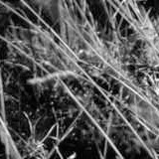
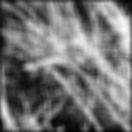
Smoothing with box filter

Slide 20
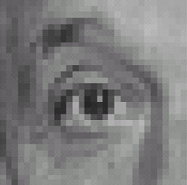
Practice with linear filters
0
0
0
?
0
1
0
0
0
0
Original
Source: D. Lowe

Slide 21
Practice with linear filters
0
0
0
0
1
0
0
0
0
Original
Filtered
(no change)
Source: D. Lowe

Slide 22
Practice with linear filters
0
0
0
?
0
0
1
0
0
0
Original
Source: D. Lowe

Slide 23
Practice with linear filters
0
0
0
0
0
1
0
0
0
Original
Shifted left
By 1 pixel
Source: D. Lowe

Slide 24

Practice with linear filters
0
0
0
-
1
1
1
?
0
2
0
1
1
1
0
0
0
1
1
1
(Note that filter sums to 1)
Original
Source: D. Lowe

Slide 25
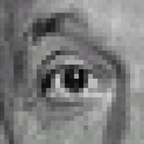
Practice with linear filters
0
0
0
-
1
1
1
0
2
0
1
1
1
0
0
0
1
1
1
Original
Sharpening filter
Accentuates differences with local average
Source: D. Lowe

Slide 26
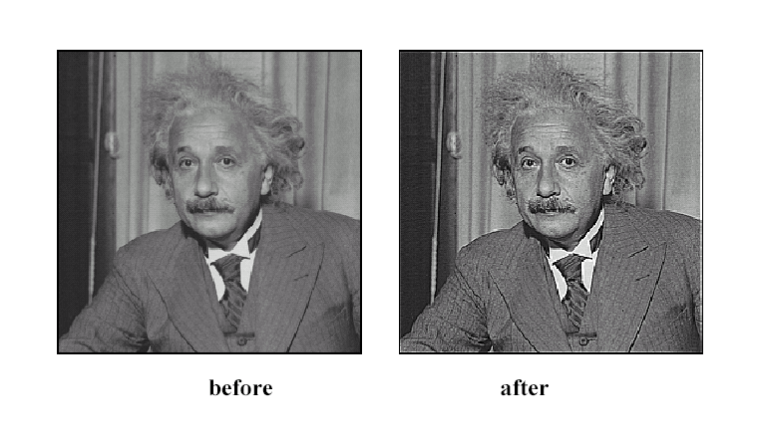
Sharpening
Source: D. Lowe

Slide 27
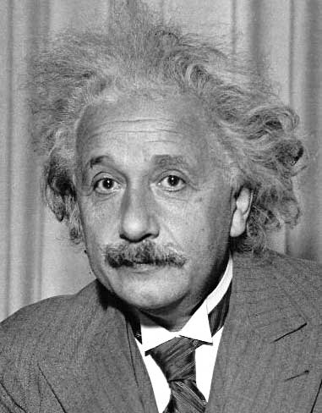
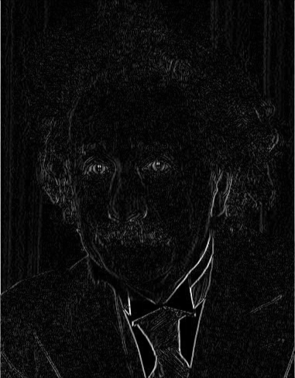
Other filters
1
0
-1
2
0
-2
1
0
-1
Sobel
Vertical Edge
(absolute value)

Slide 28
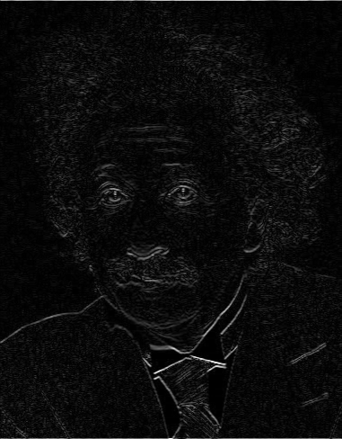
Other filters
1
2
1
0
0
0
-1
-2
-1
Sobel
Horizontal Edge
(absolute value)
Notes:
Questions at this point?

Slide 29
Back to Neural Networks and convolutional layers…

Slide 30
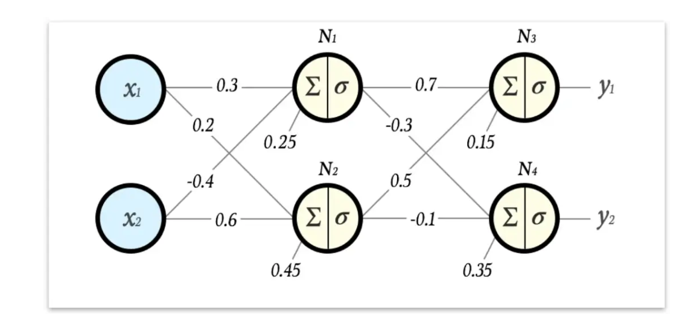

Slide 31

Fully Connected Layer
32x32x3 image -> stretch to 3072 x 1
input
activation
1
1
10 x 3072
weights
3072
10
Fei-Fei Li & Justin Johnson & Serena Yeung Lecture 5 - April 16, 2019

Slide 32
Fully Connected Layer
32x32x3 image -> stretch to 3072 x 1
input
activation
1
1
10 x 3072
weights
3072
10
1 number:
the result of taking a dot product between a row of W and the input (a 3072-dimensional dot product)
Fei-Fei Li & Justin Johnson & Serena Yeung Lecture 5 - April 16, 2019

Slide 33
Convolution Layer
32x32x3 image ->
preserve spatial structure
use less weights
that are learnable to achieve a certain objective
Ensure that all locations in the mage are processed with same weights (hence convolutional)
32
height
32
depth
width
3
Fei-Fei Li & Justin Johnson & Serena Yeung Lecture 5 - April 16, 2019

Slide 34
Convolution Layer
32x32x3 image
5x5x3 filter
32
Convolve the filter with the image
i.e. “slide over the image spatially, computing dot products”
32
3
Fei-Fei Li & Justin Johnson & Serena Yeung Lecture 5 - April 16, 2019

Slide 35
Convolution Layer
Filters always extend the full depth of the input volume
32x32x3 image
5x5x3 filter
32
Convolve the filter with the image
i.e. “slide over the image spatially,
computing dot products”
32
3
Fei-Fei Li & Justin Johnson & Serena Yeung Lecture 5 - April 16, 2019

Slide 36
Convolution Layer
32x32x3 image
5x5x3 filter
32
Convolve the filter with the image
i.e. “slide over the image spatially, computing dot products”
32
3
Fei-Fei Li & Justin Johnson & Serena Yeung Lecture 5 - April 16, 2019

Slide 37
Convolution Layer
Filters always extend the full depth of the input volume
32x32x3 image
5x5x3 filter
32
Convolve the filter with the image
i.e. “slide over the image spatially,
computing dot products”
32
3
Fei-Fei Li & Justin Johnson & Serena Yeung Lecture 5 - April 16, 2019

Slide 38
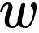
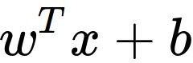
Convolution Layer
32x32x3 image 5x5x3 filter
32
1 number:
the result of taking a dot product between the filter and a small 5x5x3 chunk of the image
(i.e. 5*5*3 = 75-dimensional dot product + bias)
32
3
Fei-Fei Li & Justin Johnson & Serena Yeung Lecture 5 - April 16, 2019

Slide 39
Convolution Layer
activation map
32x32x3 image 5x5x3 filter
32
28
convolve (slide) over all spatial locations
32
28
3
1
Fei-Fei Li & Justin Johnson & Serena Yeung Lecture 5 - April 16, 2019

Slide 40
A closer look at spatial dimensions:
7
7x7 input (spatially) assume 3x3 filter
7
Fei-Fei Li & Justin Johnson & Serena Yeung Lecture 5 - April 16, 2019

Slide 41
A closer look at spatial dimensions:
7
7x7 input (spatially) assume 3x3 filter
7
Fei-Fei Li & Justin Johnson & Serena Yeung Lecture 5 - April 16, 2019

Slide 42
A closer look at spatial dimensions:
7
7x7 input (spatially) assume 3x3 filter
7
Fei-Fei Li & Justin Johnson & Serena Yeung Lecture 5 - April 16, 2019

Slide 43
A closer look at spatial dimensions:
7
7x7 input (spatially) assume 3x3 filter
7
Fei-Fei Li & Justin Johnson & Serena Yeung Lecture 5 - April 16, 2019

Slide 44
A closer look at spatial dimensions:
7
7x7 input (spatially) assume 3x3 filter
=> 5x5 output
7
Fei-Fei Li & Justin Johnson & Serena Yeung Lecture 5 - April 16, 2019

Slide 45
A closer look at spatial dimensions:
7
7x7 input (spatially) assume 3x3 filter applied with stride 2
7
Fei-Fei Li & Justin Johnson & Serena Yeung Lecture 5 - April 16, 2019

Slide 46
A closer look at spatial dimensions:
7
7x7 input (spatially) assume 3x3 filter applied with stride 2
7
Fei-Fei Li & Justin Johnson & Serena Yeung Lecture 5 - April 16, 2019

Slide 47
A closer look at spatial dimensions:
7
7x7 input (spatially) assume 3x3 filter applied with stride 2
=> 3x3 output!
7
Fei-Fei Li & Justin Johnson & Serena Yeung Lecture 5 - April 16, 2019

Slide 48
N
Output size:
(N - F) / stride + 1
 |  |  | F
 | F
e.g. N = 7, F = 3:
stride 1 => (7 - 3)/1 + 1 = 5
stride 2 => (7 - 3)/2 + 1 = 3
N
Fei-Fei Li & Justin Johnson & Serena Yeung Lecture 5 - April 16, 2019

Slide 49
In practice: Common to zero pad the border
0 | 0 | 0 | 0 | 0 | 0
0
0
0
0
e.g. input 7x7
3x3 filter, applied with stride 1
pad with 1 pixel border => what is the output?
Fei-Fei Li & Justin Johnson & Serena Yeung Lecture 5 - April 16, 2019

Slide 50
In practice: Common to zero pad the border
0 | 0 | 0 | 0 | 0 | 0
0
0
0
0
e.g. input 7x7
3x3 filter, applied with stride 1
pad with 1 pixel border => what is the output?
7x7 output!
Fei-Fei Li & Justin Johnson & Serena Yeung Lecture 5 - April 16, 2019

Slide 51
In practice: Common to zero pad the border
0 | 0 | 0 | 0 | 0 | 0
0
0
0
0
e.g. input 7x7
3x3 filter, applied with stride 1
pad with 1 pixel border => what is the output?
7x7 output!
in general, common to see CONV layers with stride 1, filters of size FxF, and zero-padding with (F-1)/2. (will preserve size spatially)
e.g. F = 3 => zero pad with 1 F = 5 => zero pad with 2 F = 7 => zero pad with 3
Fei-Fei Li & Justin Johnson & Serena Yeung Lecture 5 - April 16, 2019

Slide 52
consider a second, green filter
Convolution Layer
32x32x3 image 5x5x3 filter
activation maps
32
28
convolve (slide) over all spatial locations
32
28
3
1
Lecture 5 - 35
Fei-Fei Li & Justin Johnson & Serena Yeung Lecture 5 - April 16, 2019

Slide 53
For example, if we had 6 5x5 filters, we’ll get 6 separate activation maps:
activation maps
32
28
Convolution Layer
32
28
3
6
We stack these up to get a “new image” of size 28x28x6!
Fei-Fei Li & Justin Johnson & Serena Yeung Lecture 5 - April 16, 2019

Slide 54
Preview: ConvNet is a sequence of Convolution Layers, interspersed with activation functions
32
28
CONV, ReLU
e.g. 6 5x5x3 filters
32
28
3
6
Fei-Fei Li & Justin Johnson & Serena Yeung Lecture 5 - April 16, 2019

Slide 55
Preview: ConvNet is a sequence of Convolution Layers, interspersed with activation functions
32
28
24
….
CONV, ReLU
e.g. 6 5x5x3 filters
CONV, ReLU
e.g. 10 5x5x6 filters
CONV, ReLU
32
28
24
3
6
10
Fei-Fei Li & Justin Johnson & Serena Yeung Lecture 5 - April 16, 2019

Slide 56
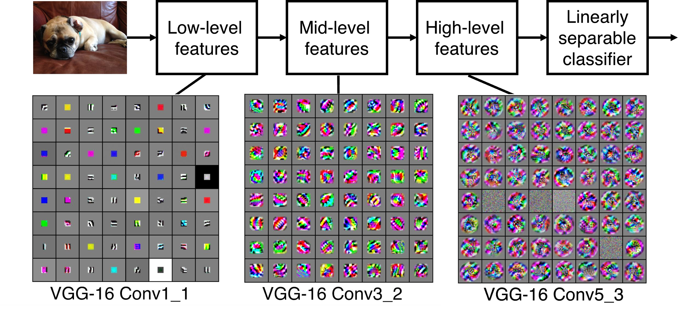
Preview
[Zeiler and Fergus 2013]
Visualization of VGG-16 by Lane McIntosh. VGG-16 architecture from [Simonyan and Zisserman 2014].
Fei-Fei Li & Justin Johnson & Serena Yeung Lecture 5 - April 16, 2019

Slide 57
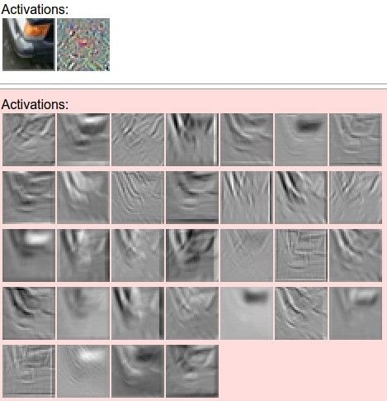
one filter =>
one activation map
Figure copyright Andrej Karpathy.
Fei-Fei Li & Justin Johnson & Serena Yeung Lecture 5 - April 16, 2019

Slide 58

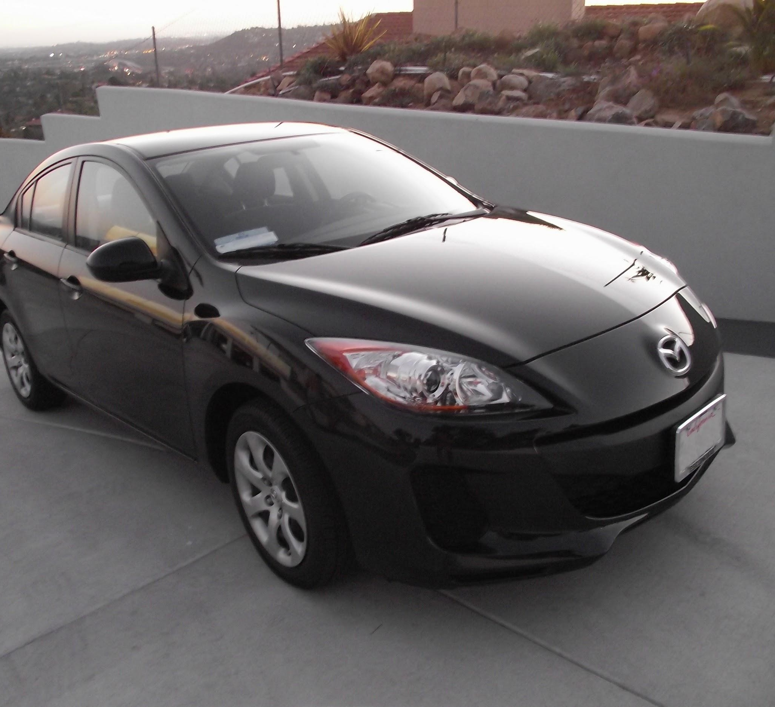
two more layers to go: POOL/FC
Fei-Fei Li & Justin Johnson & Serena Yeung Lecture 5 - April 16, 2019

Slide 59
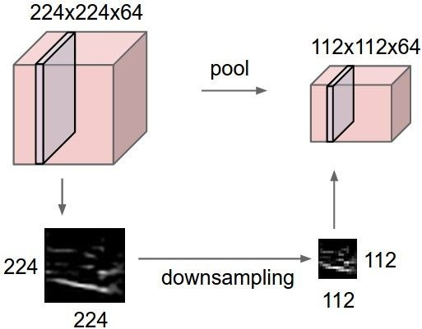
Pooling layer
makes the representations smaller and more manageable
operates over each activation map independently:
only pooling spatially not on depth
the idea is to be insensitive to some deformations/translation
pooling can be done using strides as well
Fei-Fei Li & Justin Johnson & Serena Yeung Lecture 5 - April 16, 2019

Slide 60
MAX POOLING
Single depth slice
1 | 1 | 2 | 4
5 | 6 | 7 | 8
3 | 2 | 1 | 0
1 | 2 | 3 | 4
x
max pool with 2x2 filters and stride 2
6 | 8
3 | 4
y
Fei-Fei Li & Justin Johnson & Serena Yeung Lecture 5 - April 16, 2019

Slide 61
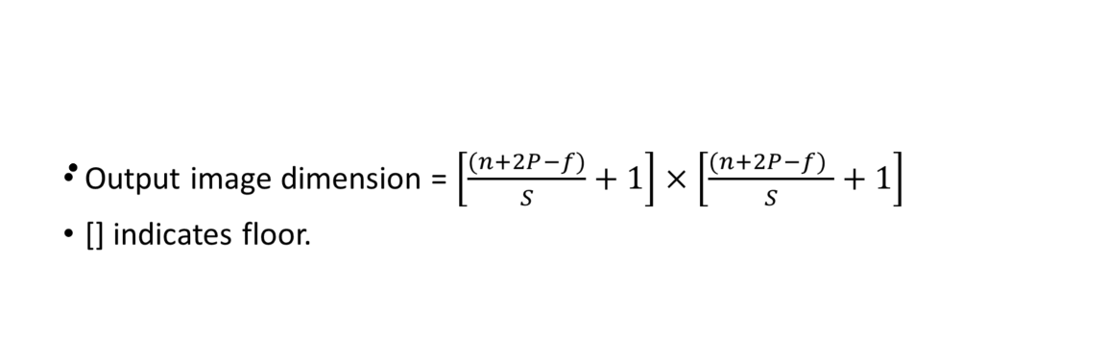

Slide 62
Fully Connected Layer (FC layer)
- Contains neurons that connect to the entire input volume, as in ordinary Neural Networks we are now pooling all info from the image to arrive at the class/label
Each small image is the activation at the layer
Fei-Fei Li & Justin Johnson & Serena Yeung Lecture 5 - April 16, 2019

Slide 63
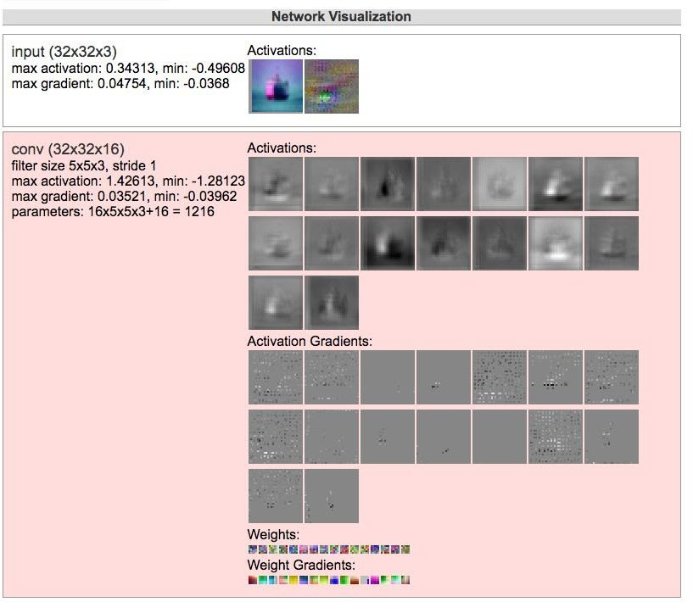
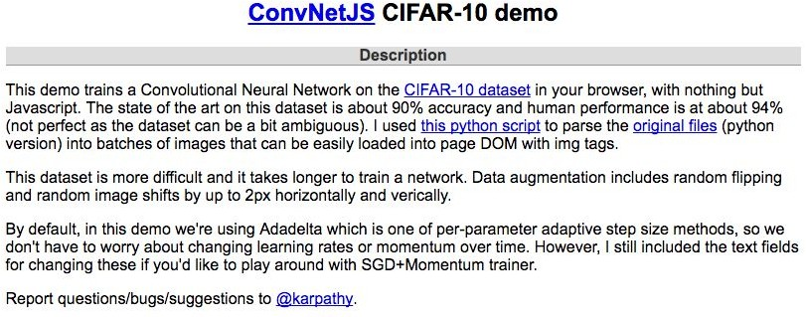
[ConvNetJS demo: training on CIFAR-10]
http://cs.stanford.edu/people/karpathy/convnetjs/demo/cifar10.html
Fei-Fei Li & Justin Johnson & Serena Yeung Lecture 5 - April 16, 2019

Slide 64
Example of convNet from Keras
def define_model():
model = Sequential()
model.add(Conv2D(32, (3, 3), activation='relu', kernel_initializer='he_uniform', input_shape=(28, 28, 1)))
model.add(MaxPooling2D((2, 2)))
model.add(Flatten())
model.add(Dense(100, activation='relu', kernel_initializer='he_uniform'))
model.add(Dense(10, activation='softmax'))
# compile model
opt = SGD(lr=0.01, momentum=0.9)
model.compile(optimizer=opt, loss='categorical_crossentropy', metrics=['accuracy'])
return model
model = define_model()
# select rows for train and test
trainX, trainY, testX, testY = dataX[train_ix], dataY[train_ix], dataX[test_ix], dataY[test_ix]
# fit model
history = model.fit(trainX, trainY, epochs=10, batch_size=32, validation_data=(testX, testY), verbose=0)
# evaluate model
_, acc = model.evaluate(testX, testY, verbose=0)
Source: https://machinelearningmastery.com/how-to-develop-a-convolutional-neural-network-from-scratch-for-mnist-handwritten-digit-classification/

Slide 65
One more thing: Transfer Learning
“You need a lot of a data if you want to train/use CNNs”
Lecture 9 -
65

Slide 66
One more thing: Transfer Learning
NOT TRUE
“You need a lot of a data if you want to train/use CNNs”
Lecture 9 -
66

Slide 67
Transfer Learning with CNNs
Donahue et al, “DeCAF: A Deep Convolutional Activation Feature for Generic Visual Recognition”, ICML 2014 Razavian et al, “CNN Features Off-the-Shelf: An Astounding Baseline for Recognition”, CVPR Workshops 2014
1. Train on Imagenet
FC-1000
FC-4096
FC-4096
MaxPool
Conv-512
Conv-512
MaxPool
Conv-512
Conv-512
MaxPool
Conv-256
Conv-256
MaxPool
Conv-128
Conv-128
MaxPool
Conv-64
Conv-64
Image
Lecture 9 -
8
Fei-Fei Li & Justin Johnson & Serena Yeung Lecture 9 - April 30, 2019

Slide 68

Transfer Learning with CNNs
Donahue et al, “DeCAF: A Deep Convolutional Activation Feature for Generic Visual Recognition”, ICML 2014 Razavian et al, “CNN Features Off-the-Shelf: An Astounding Baseline for Recognition”, CVPR Workshops 2014
1. Train on Imagenet
2. Small Dataset (C classes)
FC-1000
FC-4096
FC-4096
 | FC-C
 | FC-4096
 | FC-4096
Reinitialize this and train
MaxPool
Conv-512
Conv-512
MaxPool
Conv-512
Conv-512
MaxPool
Conv-512
Conv-512
MaxPool
Conv-512
Conv-512
MaxPool
Conv-256
Conv-256
MaxPool
Conv-256
Conv-256
Freeze these
MaxPool
Conv-128
Conv-128
MaxPool
Conv-128
Conv-128
MaxPool
Conv-64
Conv-64
MaxPool
Conv-64
Conv-64
Image
Image
Lecture 9 -
9
Fei-Fei Li & Justin Johnson & Serena Yeung Lecture 9 - April 30, 2019

Slide 69
Transfer Learning with CNNs
Donahue et al, “DeCAF: A Deep Convolutional Activation Feature for Generic Visual Recognition”, ICML 2014 Razavian et al, “CNN Features Off-the-Shelf: An Astounding Baseline for Recognition”, CVPR Workshops 2014
3. Bigger dataset
1. Train on Imagenet
2. Small Dataset (C classes)
FC-1000
FC-4096
FC-4096
 | FC-C
 | FC-4096
 | FC-4096
FC-C
FC-4096
FC-4096
Reinitialize this and train
Train these
MaxPool
Conv-512
Conv-512
MaxPool
Conv-512
Conv-512
MaxPool
Conv-512
With bigger dataset, train more layers
Conv-512
MaxPool
Conv-512
Conv-512
MaxPool
Conv-512
Conv-512
MaxPool
Conv-512
Conv-512
MaxPool
Conv-256
Conv-256
MaxPool
Conv-256
Conv-256
Freeze these
MaxPool
Conv-256
Conv-256
Freeze these
Lower learning rate when finetuning; 1/10 of original LR is good starting point
MaxPool
Conv-128
Conv-128
MaxPool
Conv-128
Conv-128
MaxPool
Conv-128
Conv-128
MaxPool
Conv-64
Conv-64
MaxPool
Conv-64
Conv-64
MaxPool
Conv-64
Conv-64
Image
Image
Image
Lecture 9 -
Fei-Fei Li & Justin Johnson & Serena Yeung Lecture 9 - April 30, 2019

Slide 70
 | very similar dataset | very different dataset
very little data | ? | ?
quite a lot of data | ? | ?
FC-1000
FC-4096
FC-4096
MaxPool
Conv-512
Conv-512
MaxPool
Conv-512
Conv-512
More specific
More generic
MaxPool
Conv-256
Conv-256
MaxPool
Conv-128
Conv-128
MaxPool
Conv-64
Conv-64
Image
Lecture 9 -
Fei-Fei Li & Justin Johnson & Serena Yeung Lecture 9 - April 30, 2019

Slide 71
 | very similar dataset | very different dataset
very little data | Use Linear Classifier on top layer | ?
quite a lot of data | Finetune a few layers | ?
FC-1000
FC-4096
FC-4096
MaxPool
Conv-512
Conv-512
MaxPool
Conv-512
Conv-512
More specific
More generic
MaxPool
Conv-256
Conv-256
MaxPool
Conv-128
Conv-128
MaxPool
Conv-64
Conv-64
Image
Lecture 9 -
Fei-Fei Li & Justin Johnson & Serena Yeung Lecture 9 - April 30, 2019

Slide 72
 | very similar dataset | very different dataset
very little data | Use Linear Classifier on top layer | You’re in trouble… Try linear classifier from different stages
quite a lot of data | Finetune a few layers | Finetune a larger number of layers
FC-1000
FC-4096
FC-4096
MaxPool
Conv-512
Conv-512
MaxPool
Conv-512
Conv-512
More specific
More generic
MaxPool
Conv-256
Conv-256
MaxPool
Conv-128
Conv-128
MaxPool
Conv-64
Conv-64
Image
Lecture 9 -
Fei-Fei Li & Justin Johnson & Serena Yeung Lecture 9 - April 30, 2019

Slide 73
Popular CNN architectures
73
May 10, 2017
Fei-Fei Li & Justin Johnson & Serena Yeung Lecture 11 - May 10, 2017

Slide 74
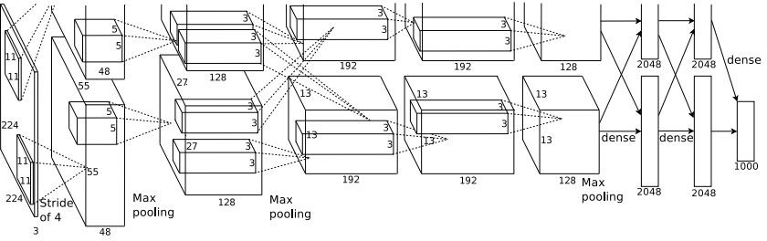
Case Study: AlexNet
[Krizhevsky et al. 2012]
Architecture:
CONV1 MAX POOL1 NORM1 CONV2 MAX POOL2 NORM2 CONV3 CONV4 CONV5
Max POOL3 FC6
FC7 FC8
Figure copyright Alex Krizhevsky, Ilya Sutskever, and Geoffrey Hinton, 2012. Reproduced with permission.
Lecture 9 -
Fei-Fei Li & Justin Johnson & Serena Yeung Lecture 9 - April 30, 2019

Slide 75
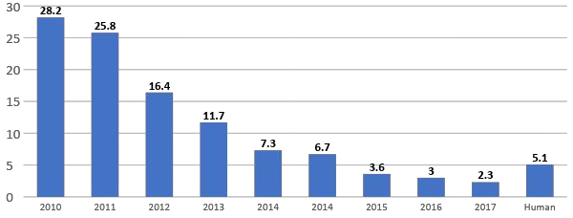
ImageNet Large Scale Visual Recognition Challenge (ILSVRC) winners
152 layers
152 layers
152 layers
19 layers
22 layers
shallow
8 layers
8 layers
Lin et al | Sanchez & | Krizhevsky et al Zeiler & | Simonyan & Szegedy et al | He et al | Shao et al | Hu et al | Russakovsky et al
 | Perronnin | (AlexNet) Fergus | Zisserman (VGG) (GoogLeNet) | (ResNet) |  | (SENet)
Lecture 9 -
Fei-Fei Li & Justin Johnson & Serena Yeung Lecture 9 - April 30, 2019

Slide 76
ImageNet Large Scale Visual Recognition Challenge (ILSVRC) winners
“Revolution of Depth”
152 layers
152 layers
152 layers
19 layers
22 layers
shallow
8 layers
8 layers
Lin et al
Sanchez & Perronnin
Krizhevsky et al Zeiler & (AlexNet) Fergus
Simonyan & Szegedy et al Zisserman (VGG) (GoogLeNet)
He et al (ResNet)
Shao et al
Hu et al (SENet)
Russakovsky et al
Lecture 9 -
Fei-Fei Li & Justin Johnson & Serena Yeung Lecture 9 - April 30, 2019

Slide 77
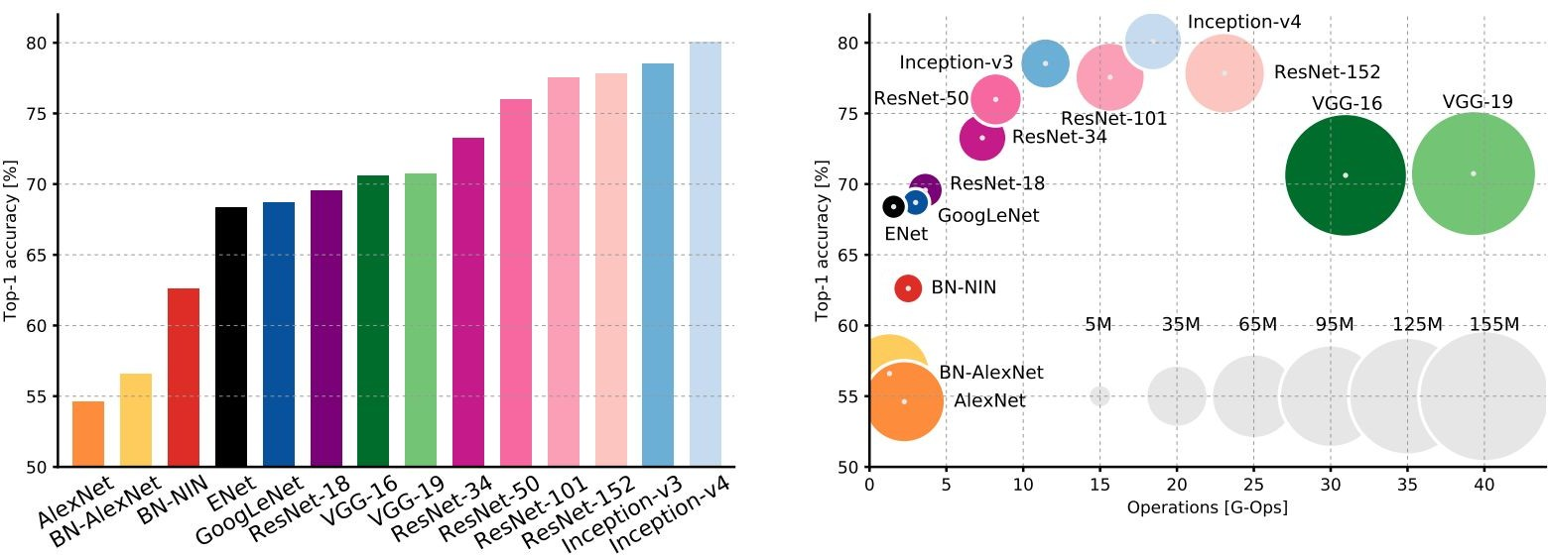
Comparing complexity...
Blob size represents memory used
An Analysis of Deep Neural Network Models for Practical Applications, 2017.
Figures copyright Alfredo Canziani, Adam Paszke, Eugenio Culurciello, 2017. Reproduced with permission.
In computing, floating point operations per second is a measure of computer performance, useful in fields of scientific computations that require floating-point calculations. For such cases it is a more accurate measure than measuring instructions per second. (Wikipedia link)
Lecture 9 -
Fei-Fei Li & Justin Johnson & Serena Yeung Lecture 9 - April 30, 2019

